Slide 1

Ceremony Seat Management System Group:2
Submitted by:
Sl No. | Name | ID
1 | MD. Rakib Hassan Pial | 2025-2-60-064
2 | Hamim Khan | 2025-2-60-065
3 | Syeda Shazia Binte Alam | 2025-2-60-066
4 | Irshia Haque | 2025-2-60-067
5 | Nabil Arefin | 2025-2-60-069

Slide 2
About the Ceremony Seat Management System
The Ceremony Seat Management System is a text-based C program that is developed to arrange seat plans for various events such as conferences, wedding receptions , graduation ceremonies and other gatherings. The system helps the organizer to arrange seats by choosing how many rows there are and how many seats are in each row. Then they can book seats, cancel bookings, change seat assignments, and see the current seating plan.

Slide 3
Project Overview
Project Goal
To build a simple C-based system that allows booking and managing seats in a ceremony system.
Key Features
Display seating chart
Book, cancel, and update seats
Save/Load seat data via text file
Error handling & validation
User friendly menu system

Slide 4
Programming Concepts Used
FUNCTIONS
2D ARRAYS
LOOPS
CONDITIONALS
FILE HANDLING

Slide 5
2. ALL FUNCTION DESCRIPTION WITH OUTPUTS
2.1 Head Message:
Description:
This function displays the header of the program. It shows the title “Ceremony Seat Management System” in a decorative format. It does not take any input and only produces an output message on the screen to introduce the system to the user.

Slide 6
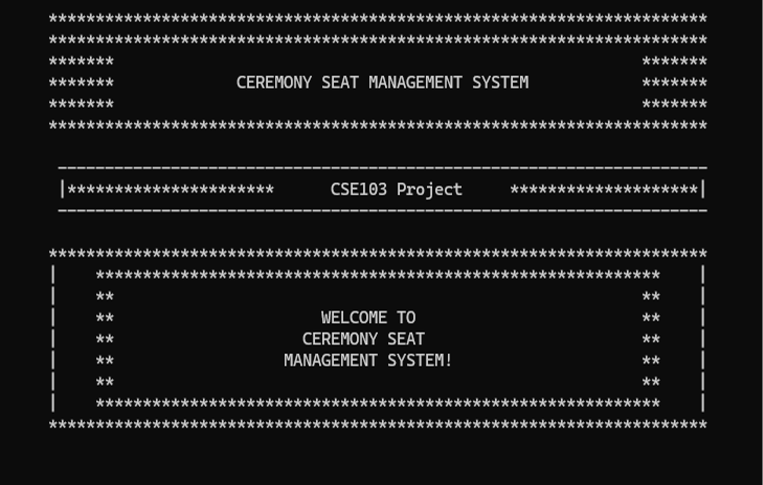
Output:

Slide 7
2.2 Display Seats (Macro Function)
Description:
This macro function shows the current seating layout. Booked seats are marked as the guest's name and available seats are marked as ‘Available’.

Slide 8
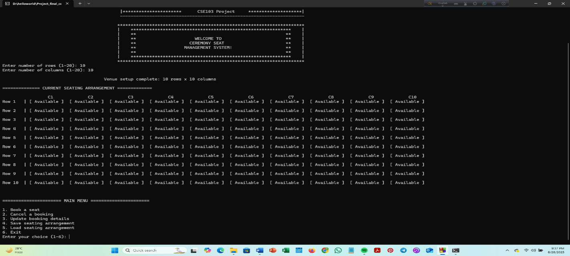
Output:

Slide 9
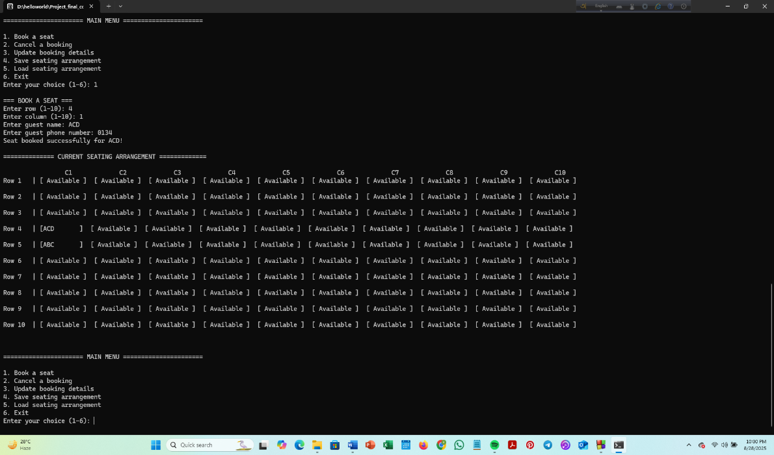
2.3 Book a seat (choice 1)
Description:
This part lets the user book a seat by entering row, column, guest's name and contact number. It also prevents double booking.

Slide 10
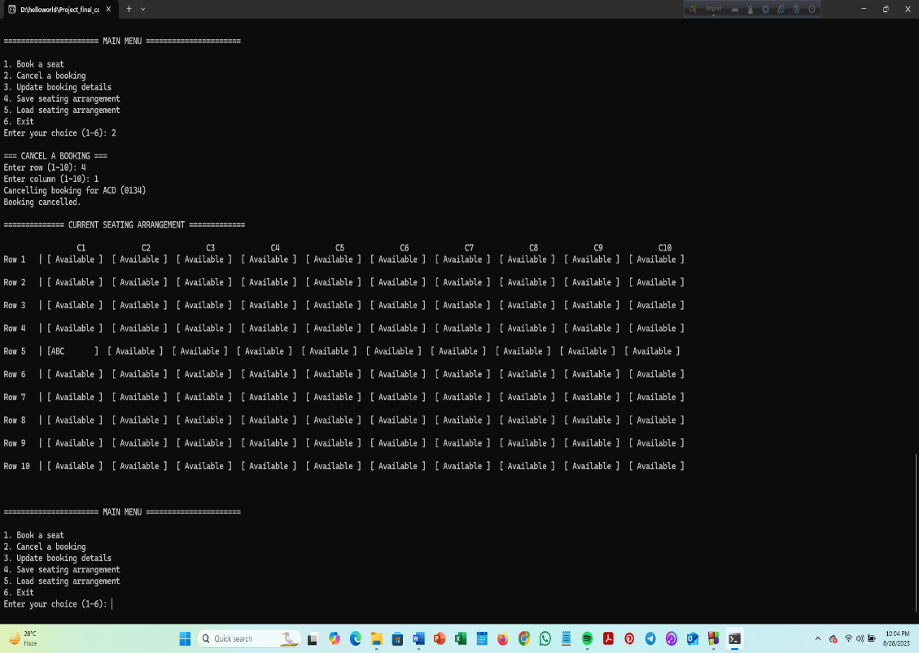
2.4 Cancel a Booking (choice 2)
Description:
This part allows the user to cancel booking for a seat. After cancelling a booking the seat becomes available again

Slide 11
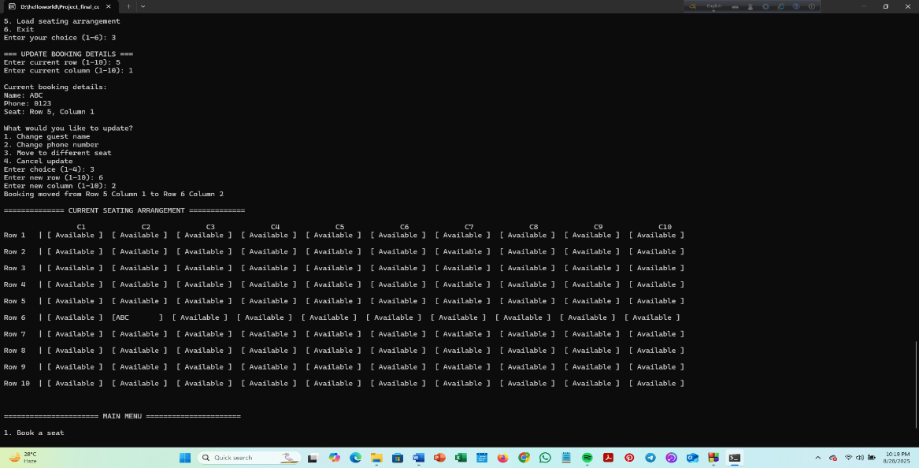
2.5 Update Booking Details (choice 3)
Description:
This option lets the user to change the guest's name, number and even the seat position for a
previously booked seat.

Slide 12
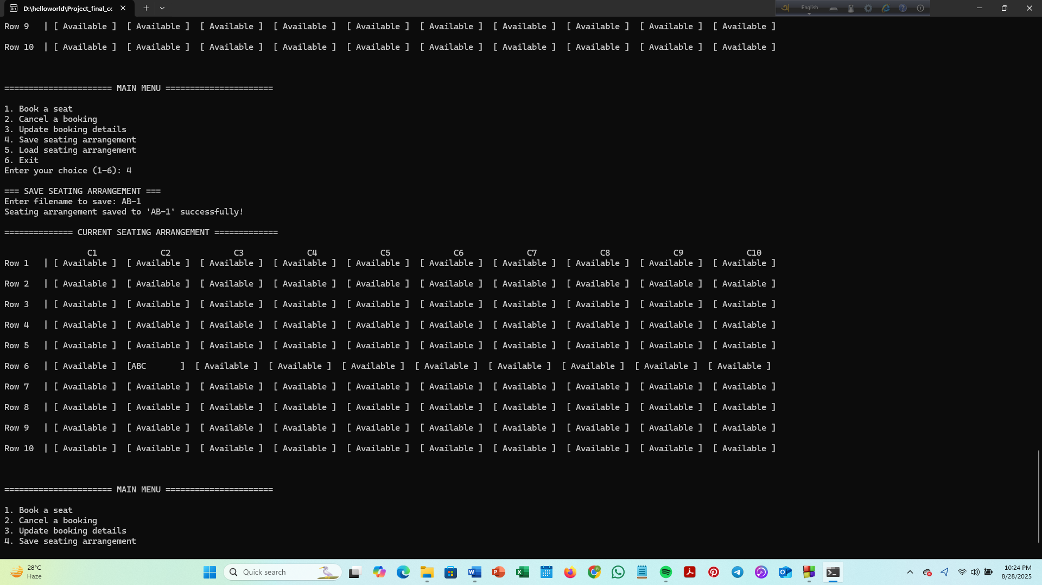
2.6 Save Seating Arrangements (choice 4)
Description:
This option saves the seating arrangement into a binary file. This is useful if we want to re-open the
program later and continue.

Slide 13
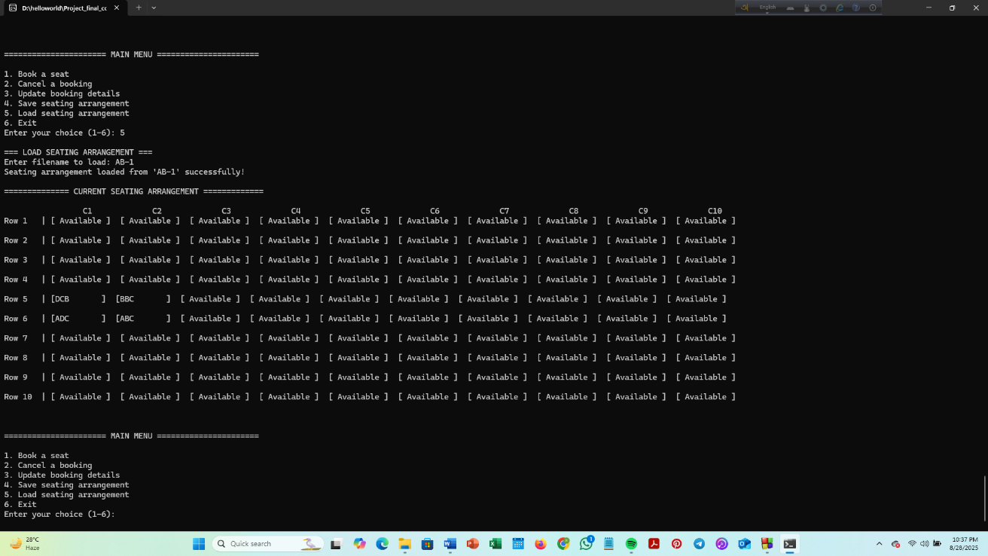
2.7 Load Seating Arrangements (choice 6)
Description:
This option lets the user to open a previously saved program.

Slide 14
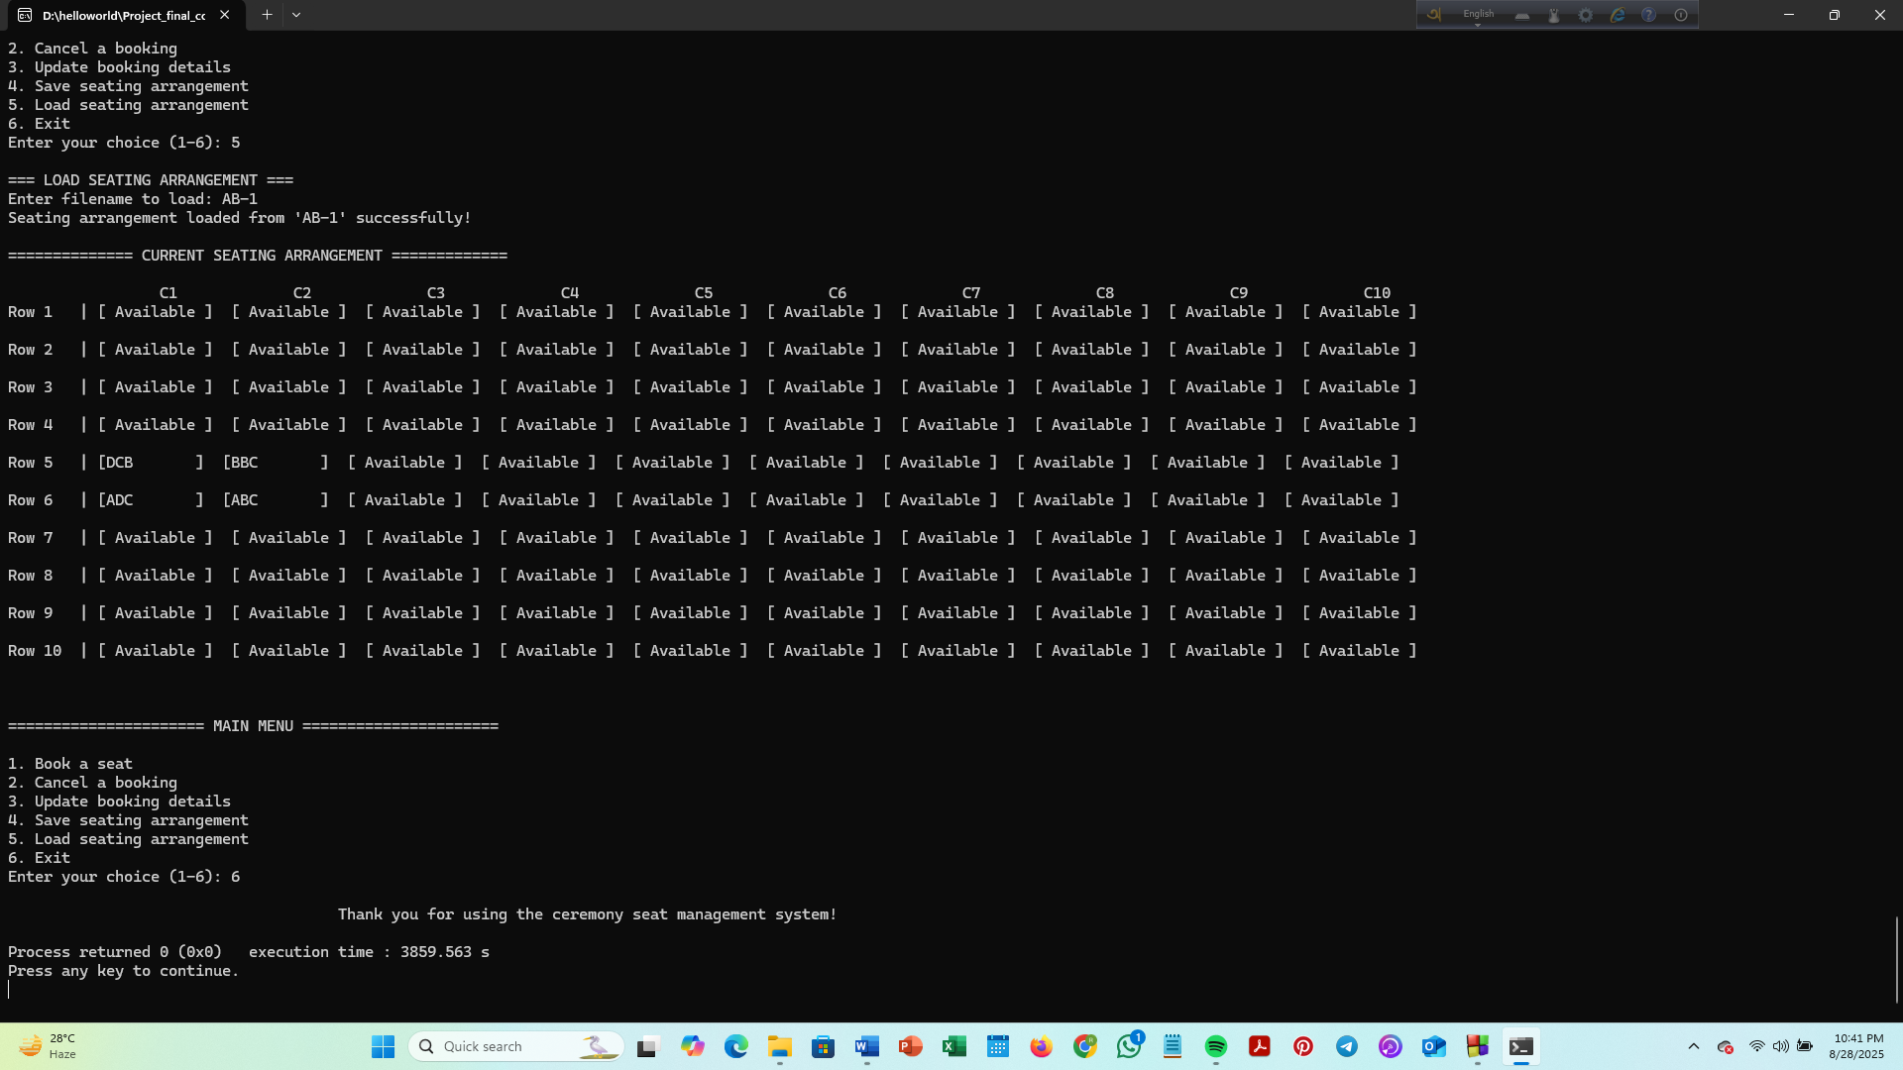
2.8 Exit (choice 6)
Description:
This option ends the program with a thank you message.

Slide 15
3. Conclusion
After finishing this project, we understood how we can use C programming to solve real-life problems like managing seats in an event.
We faced some challenges like handling input validation (making sure users cannot book outside the range), preventing double bookings, and printing the perfect layout for seat arrangement. But solving these problems helped us learn more.
This project improved our skills in arrays, functions, teamwork and many other things. We also realized the importance of breaking a big problem into smaller tasks.
We believe this project can be useful for small events or functions, and it gave us confidence in programming.

Slide 16
THANK YOU!

